Slide 1



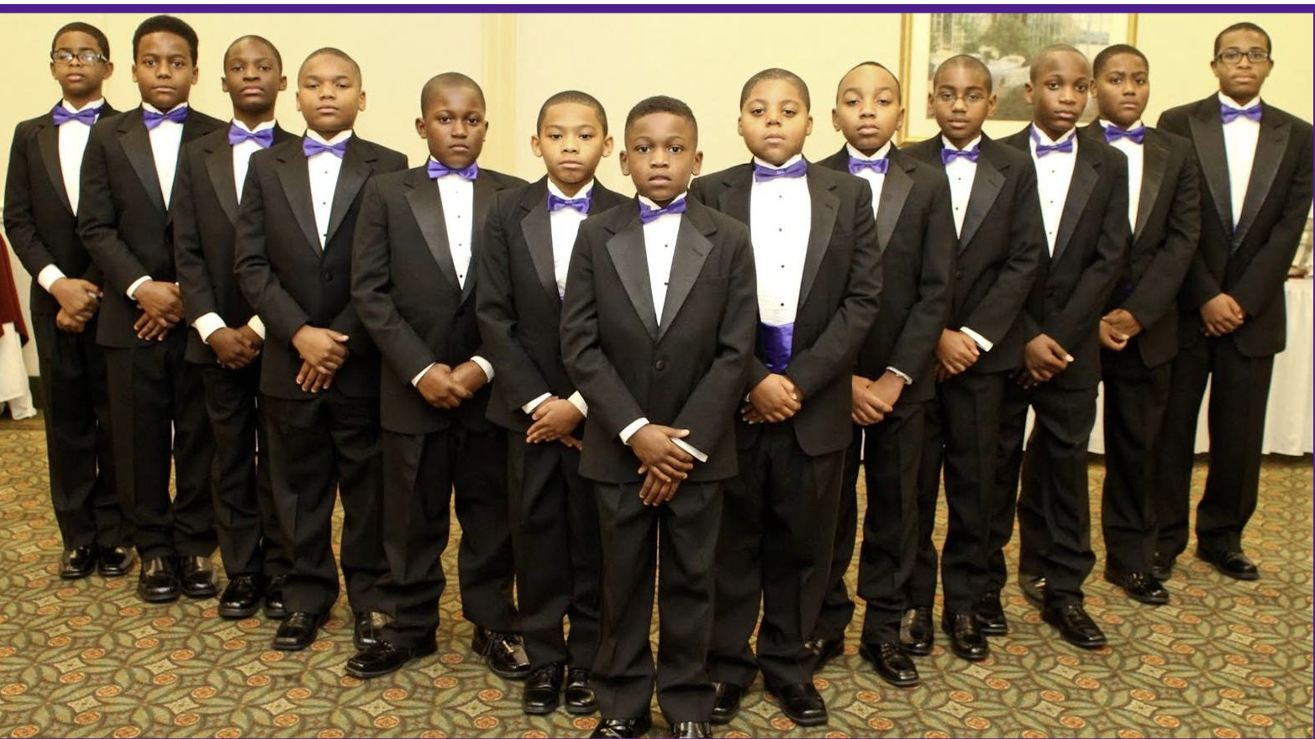

Prince to King Mentor Program
Information Meeting
September 12, 2021
Alpha Kappa Alpha Sorority, Incorporated®
Rho Chi Omega Chapter
“The King in Me”
Unlocking
the
Future
Navigating Our Present
Discovering
Our
Past

Slide 2


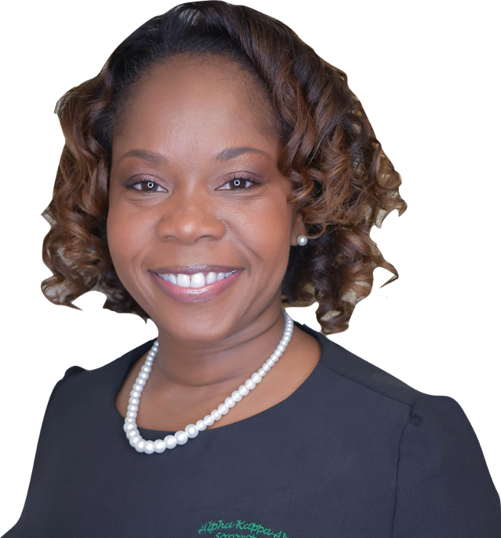
“The King in Me”
Discovering Our Past Navigating Our Present Unlocking the Future
Greetings
Mrs. Tonnesha M. Lewis
President, Rho Chi Omega

Slide 3
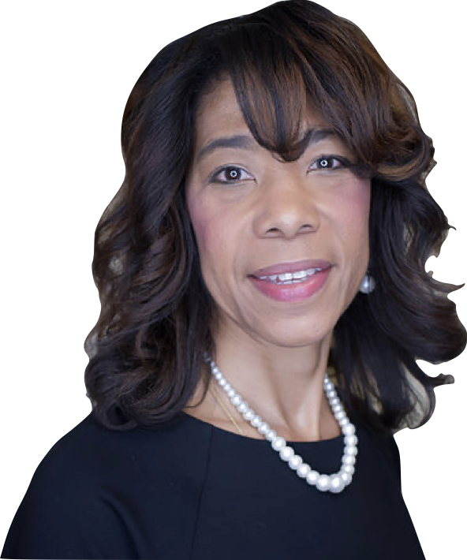
“The King in Me”
Discovering Our Past Navigating Our Present Unlocking the Future
Meditation
Mrs. Angelen Brooks
Chaplain, Rho Chi Omega

Slide 4
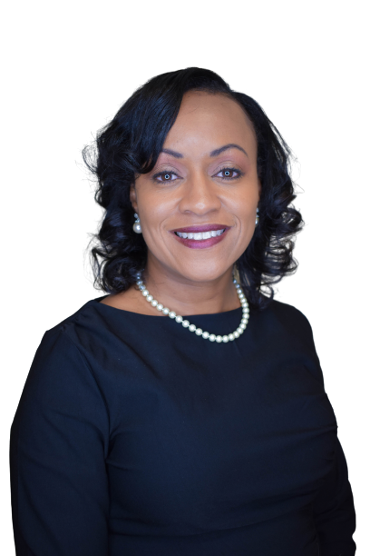
“The King in Me”
Discovering Our Past Navigating Our Present Unlocking the Future
Introduction
of the
Prince to King (P2K) Committee
Mrs. Tiffany Richardson

Slide 5
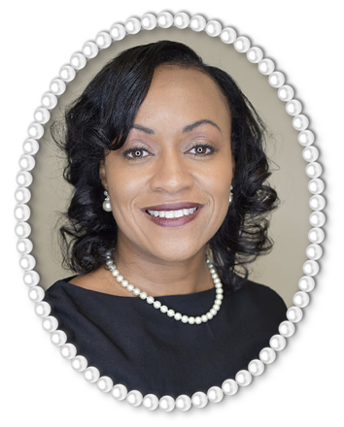
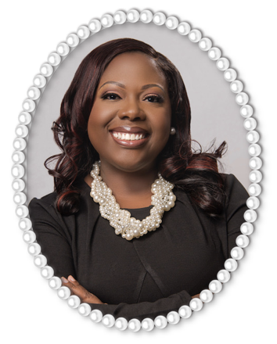
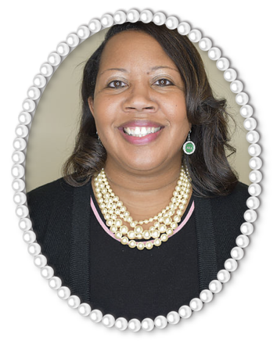
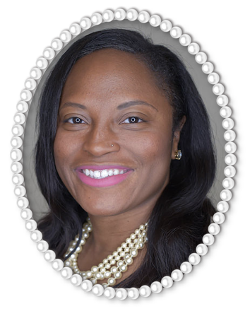
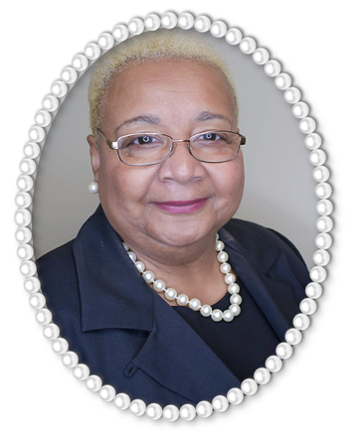
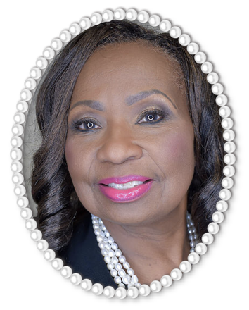
Prince to King Committee
Mrs. Tiffany Richardson
P2K Chairman
Mrs. Saleeta Spencer-Thomas
P2K Co-Chairman
Ms. Angela
Boyd
Ms. Nyah
Brown
Ms. Jacqueline Dennis
Ms. Gloria Flowers

Slide 6
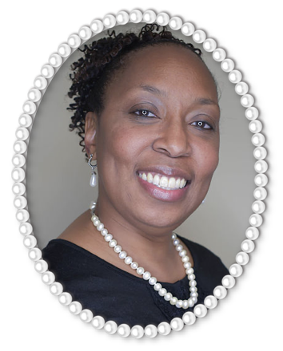
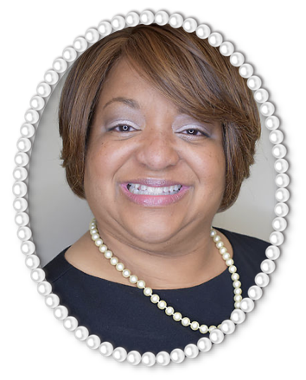
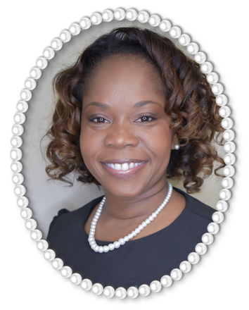
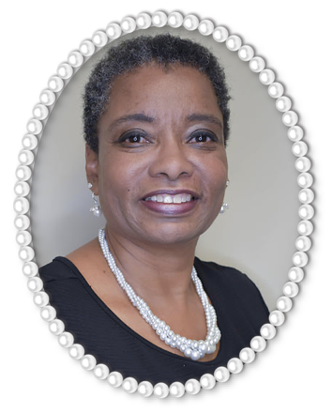
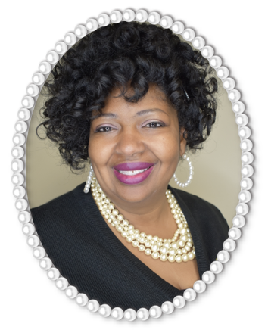
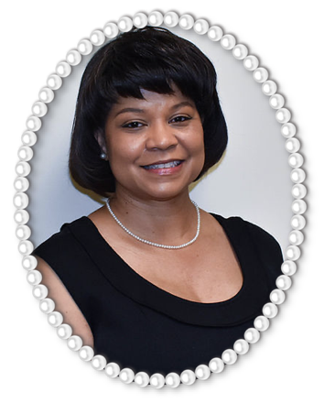
Prince to King Committee
Mrs. Sheryl Gilbreath
Ms. Cheryl K. Johnson
Mrs. Tonnesha M. Lewis
Dr. Thalia F.
Love
Mrs. Chandra Marsh
Mrs. Tracie Moore

Slide 7
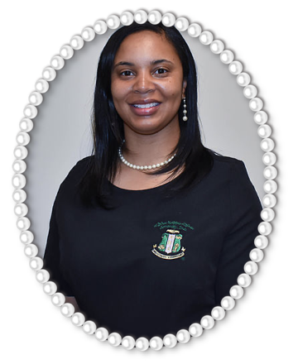
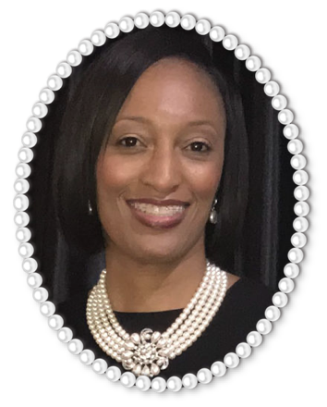
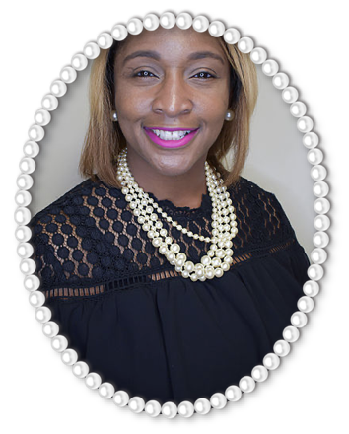
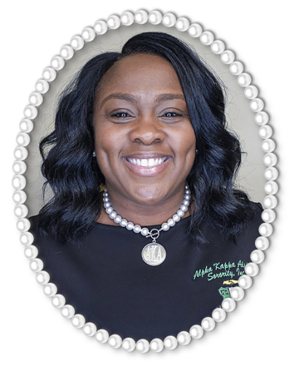
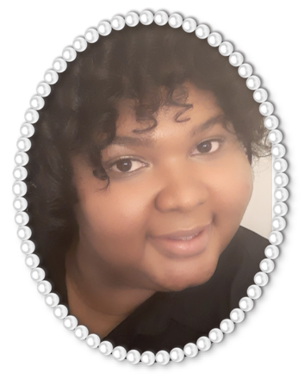
Prince to King Committee
Mrs. Lawanda Reynolds
Mrs. Acacia Sturdivant
Ms. Lakesha Taldon
Ms. Bobbie
Terry
Ms. Jessica Williams

Slide 8
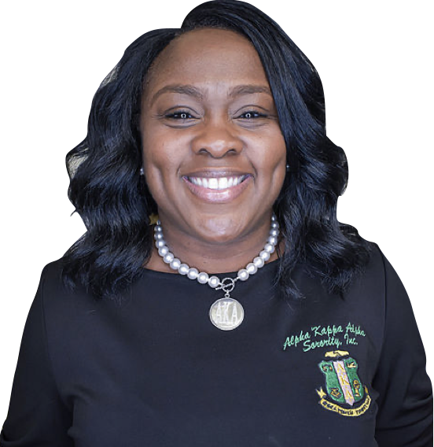
“The King in Me”
Discovering Our Past Navigating Our Present Unlocking the Future
Prince to King History and Overview
Ms. Bobbie Terry

Slide 9
Prince to King
For unto us a Child is born, Unto us a Son is given; And the government will be upon His shoulder. And His name will be called Wonderful, Counselor, Mighty God, Everlasting Father, Prince of Peace..
NKJV Isaiah 9:6
Program History and Overview
He shall be called
KING!

Slide 10
Standing Theme:
“The King in Me”
2021 Sub-Theme:
“Discovering Our Past, Navigating Our Present, Unlocking Our Future”
Standing Moto:
“Every morning when I wake I shall first thank God for a new day. Every day I shall think: Today I must do something to prepare myself to be KING.”
Program History and Overview

Slide 11
Program History and Overview
Crown signifies their place in society
Shield/Breast plate protects them from all hurt, harm and danger.
The Wings shall give them flight and carry them to places beyond their wildest dreams.
Book and Lamp of Knowledge signifies
Education and Knowledge are important.
Clasp Hands and Globe signifies
Community and Service.
Man of Justice and Scale of Law:
Leadership and Equality
Mounted Knight signifies
Chivalry (proper etiquette and manners).
The Legs allow them to stand and remain balanced during their toughest challenges.

Slide 12
“The King in Me”
Discovering Our Past Navigating Our Present Unlocking the Future
Parent and Participant Handbook
Mrs. Tiffany Richardson

Slide 13
What is Our Goal?
Enrichment Workshop and Activities
Motivate
Educate
Encourage
The program activities will include financial management, etiquette, self-esteem, academics, leadership, community service, team building and oratorical skills.
Enrichment workshops will be facilitated by positive male leaders in our community.
The participants will participate in cultural, entertaining, and educational activities.
Activities at a Glance:
Three (3) Personal Enrichment Workshops
Oratorical Competition
Community Service Project
Teambuilding Activity
STEAM Vision Board
The personal enrichment workshops will be held virtually via Zoom video conferencing.
The Oratorical Competition will be held in person.

Slide 14
Calendar of Events

Slide 15
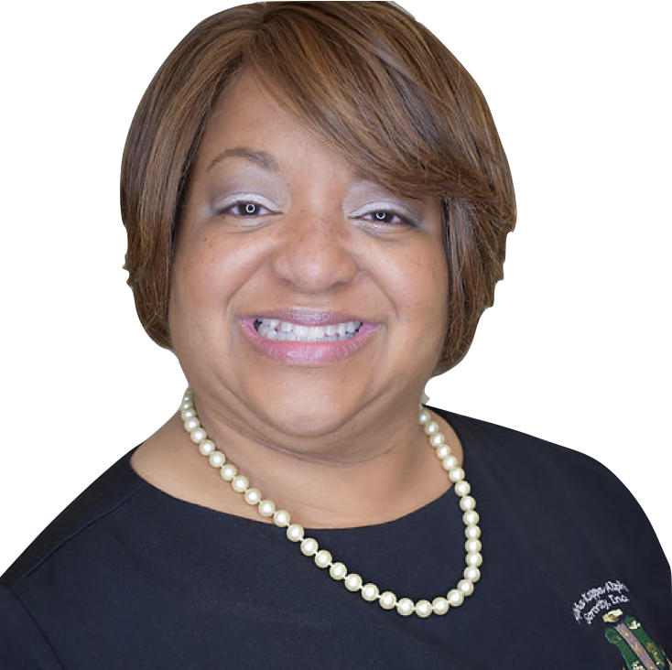
“The King in Me”
Discovering Our Past Navigating Our Present Unlocking the Future
Closing Ceremony
and
Souvenir Journal
Ms. Cheryl K. Johnson

Slide 16

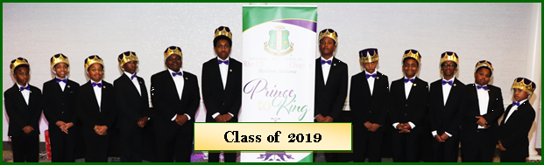
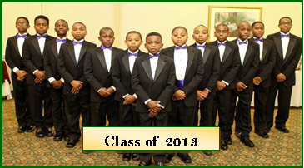
Closing Ceremony
“The King in Me”
Closing Ceremony
Sunday, December 5, 2021
4:00 p.m.
Virtual via Zoom
Attire: Semi-formal
Closing Ceremony Attire for the P2K Participants
Black Suit (uninterrupted black i.e. no pinstripes)
White Shirt
Neck Tie (Provided by the chapter)
Black Socks
Black Shoes

Slide 17

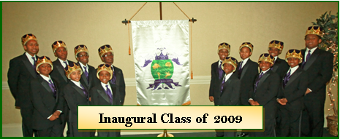
Closing Ceremony
Program Highlights
Introduction of the
Prince to King Court
Prince to King Crowning Ceremony
The Charge
Awards

Slide 18
Closing Ceremony
Awards
Participation
(Each participant will receive an award.)
Future Leader (The Boss)
(Winner for each category)
Team Builder (Mr. Inclusion)
(Winner for each category)
Best Speaker (Mr. Communicator)
(Winner for each category)
King (Mr. Congeniality)
(One overall winner)
Awards will be announced the night of the Closing Ceremony.
The P2K participants will be able to pick up all awards on December 12, 2021. See Parent and Participant Handbook.

Slide 19
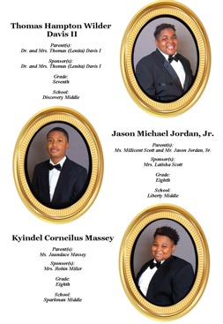
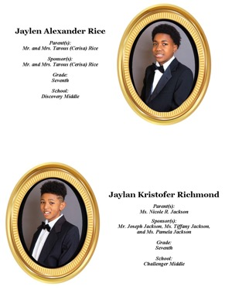
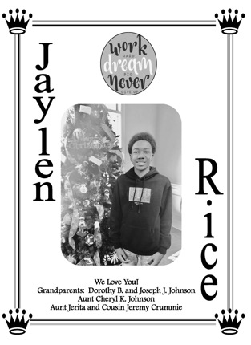
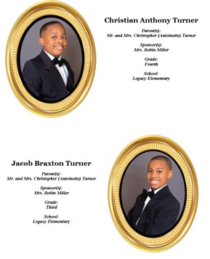

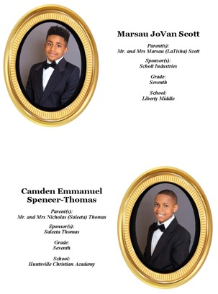
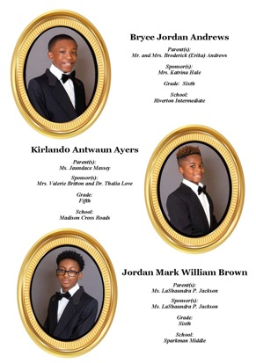
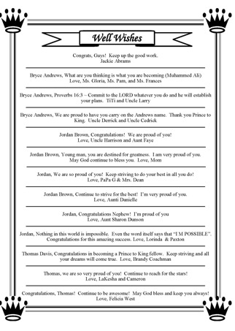
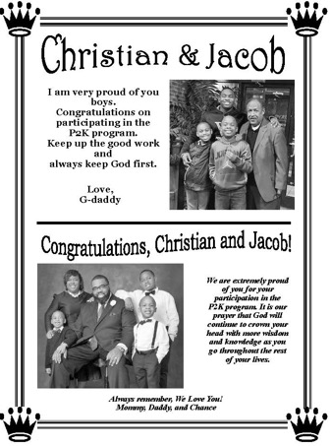
Souvenir Journal

Slide 20
Souvenir Journal
Encourage your family, friends, and businesses to support your participation by purchasing ads.
Participant’s photographs will be taken by an official photographer compliments of the sorority.
Ad deadline is November 13, 2021.
Payment via online tool provided by chapter or in person on November 13, 2021. See Parent and Participant Handbook for details.
Each participant will receive a complimentary copy of the souvenir journal.
Additional journals may be pre-ordered for $12.00 each by November 13, 2021.
Ad prices:
Full page with one picture $100.00
Half page with no picture $75.00
Half page with one picture $80.00
Well Wisher (one line) $25.00

Slide 21
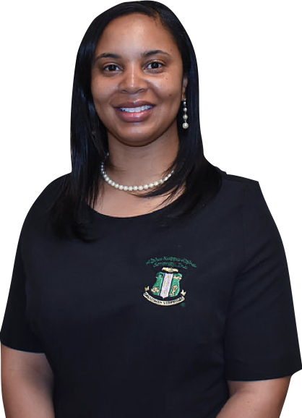
“The King in Me”
Discovering Our Past Navigating Our Present Unlocking the Future
Program Registration
Mrs. Lawanda Reynolds

Slide 22
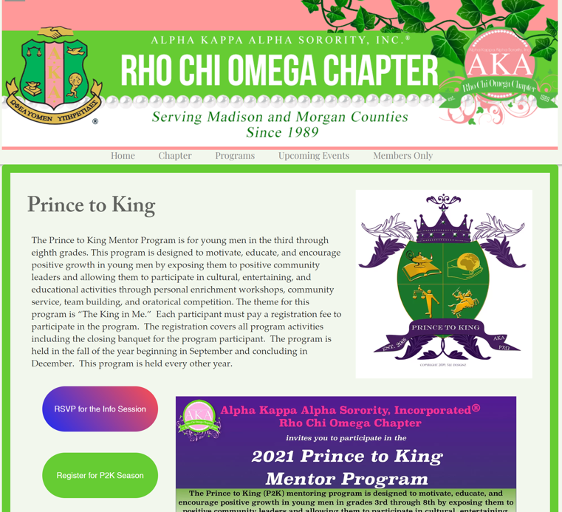
Program Registration
To register...
Open and fill out the P2K Registration Forms
Email your completed forms to p2krcoprogram@gmail.com.
Pay the P2K Registration Fee via Givelify - $103.30 ($100 plus online processing fees). Email your payment confirmation to p2krcoprogram@gmail.com by September 15. If you prefer, you may bring $100 (cash or check) to the in-person registration event (face masks are required) on September 15 at the Madison Public Library from 5:00-7:00 PM.
https://www.aka-rco.org/prince2king
THE DEADLINE FOR REGISTRATION IS SEPTEMBER 15, 2021 by 7:00 PM

Slide 23
Questions?
“The King in Me”
Discovering Our Past Navigating Our Present Unlocking the Future
Mrs. Tiffany Richardson | P2K Chairman | 706.412.1214
Mrs. Saleeta Spencer-Thomas | P2K Co-Chairman | 256.621.6621
Website: https://www.aka-rco.org/prince2king
Email: p2krcoprogram@gmail.com

